Slide 1
Software Engineering: A Practitioner’s Approach, 6/e
Chapter 23
Estimation for Software Projects copyright © 1996, 2001, 2005
R.S. Pressman & Associates, Inc.
For University Use Only
May be reproduced ONLY for student use at the university level when used in conjunction with Software Engineering: A Practitioner's Approach.
Any other reproduction or use is expressly prohibited.
These courseware materials are to be used in conjunction with Software Engineering: A Practitioner’s Approach, 6/e and are provided with permission by R.S. Pressman & Associates, Inc., copyright © 1996, 2001, 2005
1

Slide 2
Project Planning
Project planning involves estimating several characteristics of a project and then plan the project activities based on these estimations
For effective project planning,
  a very good knowledge of various estimation techniques
  past experience is also very important
These courseware materials are to be used in conjunction with Software Engineering: A Practitioner’s Approach, 6/e and are provided with permission by R.S. Pressman & Associates, Inc., copyright © 1996, 2001, 2005

Slide 3
During the project planning the project manager performs the following activities:
  Project Estimation
  Project Scheduling
  Staffing
  Risk Management
These courseware materials are to be used in conjunction with Software Engineering: A Practitioner’s Approach, 6/e and are provided with permission by R.S. Pressman & Associates, Inc., copyright © 1996, 2001, 2005

Slide 4
Project Estimation:
  Project Size Estimation is the most important parameter based on which all other estimations like cost, duration and effort are made
  Cost Estimation: Total expenses to develop the software product is estimated
  Time Estimation: The total time required to complete the project
  Effort Estimation: The effort needed to complete the project is estimated
These courseware materials are to be used in conjunction with Software Engineering: A Practitioner’s Approach, 6/e and are provided with permission by R.S. Pressman & Associates, Inc., copyright © 1996, 2001, 2005

Slide 5
  Cost Estimation =
    After completion of estimation of all the project parameters, scheduling for manpower and other resources are done.
  Staffing:
    Team structure and staffing plans are made.
  Risk Management:
    Identify the unanticipated risks that may occur during project development
These courseware materials are to be used in conjunction with Software Engineering: A Practitioner’s Approach, 6/e and are provided with permission by R.S. Pressman & Associates, Inc., copyright © 1996, 2001, 2005

Slide 6
Project Monitoring and Control
To ensure that the software development proceeds as per plan
Includes checking whether the project is going on as per plan or not
If any problem created then the project manager must take necessary action to solve the problem.
These courseware materials are to be used in conjunction with Software Engineering: A Practitioner’s Approach, 6/e and are provided with permission by R.S. Pressman & Associates, Inc., copyright © 1996, 2001, 2005

Slide 7
To manage the work to ensure that it is completed with the required standard
To monitor the progress to check that the event is on time and within budget.
Project planning must incorporate the major issues like size & cost estimation scheduling, project monitoring, personnel selection evaluation & risk management
These courseware materials are to be used in conjunction with Software Engineering: A Practitioner’s Approach, 6/e and are provided with permission by R.S. Pressman & Associates, Inc., copyright © 1996, 2001, 2005

Slide 8
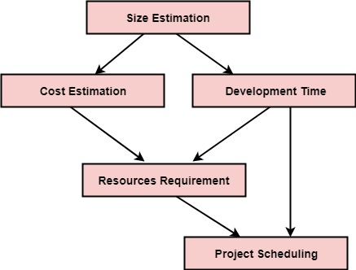
To plan a successful software project, we must understand:
  Scope of work to be completed
  Risk analysis
  The resources mandatory
These courseware materials are to be used in conjunction with Software Engineering: A Practitioner’s Approach, 6/e and are provided with permission by R.S. Pressman & Associates, Inc., copyright © 1996, 2001, 2005

Slide 9
Software Project Planning Process
The objective of project planning is to provide framework that enables the manager to make reasonable estimates of resources, cost and schedule
Why??????
So the end result gets done on time, with quality!
These courseware materials are to be used in conjunction with Software Engineering: A Practitioner’s Approach, 6/e and are provided with permission by R.S. Pressman & Associates, Inc., copyright © 1996, 2001, 2005

Slide 10
Project Planning Task Set-I
Establish project scope
Determine feasibility
Analyze risks
Define required resources
  Determine require human resources
  Define reusable software resources
  Identify environmental resources
These courseware materials are to be used in conjunction with Software Engineering: A Practitioner’s Approach, 6/e and are provided with permission by R.S. Pressman & Associates, Inc., copyright © 1996, 2001, 2005

Slide 11
Project Planning Task Set-II
Estimate cost and effort
  Decompose the problem
  Develop two or more estimates using size, function points, process tasks or use-cases
  Reconcile the estimates
Develop a project schedule
  Establish a meaningful task set
  Define a task network
  Use scheduling tools to develop a timeline chart
  Define schedule tracking mechanisms
These courseware materials are to be used in conjunction with Software Engineering: A Practitioner’s Approach, 6/e and are provided with permission by R.S. Pressman & Associates, Inc., copyright © 1996, 2001, 2005

Slide 12
Task-1:To Understand Scope ...
Understand the customers needs
understand the business context
understand the project boundaries
understand the customer’s motivation
understand the likely paths for change
understand that ...
These courseware materials are to be used in conjunction with Software Engineering: A Practitioner’s Approach, 6/e and are provided with permission by R.S. Pressman & Associates, Inc., copyright © 1996, 2001, 2005

Slide 13
What is Scope and Feasibility?
Software scope describes
  the functions and features that are to be delivered to end-users
  the data that are input and output
  the “content” that is presented to users as a consequence of using the software
  the performance, constraints, interfaces, and reliability that bound the system.
Scope is defined using one of two techniques:
    A narrative description of software scope is developed after communication with all stakeholders.
    A set of use-cases is developed by end-users.
These courseware materials are to be used in conjunction with Software Engineering: A Practitioner’s Approach, 6/e and are provided with permission by R.S. Pressman & Associates, Inc., copyright © 1996, 2001, 2005

Slide 14
Once scope has been identified, it is reasonable to ask:
  Can we build software to meet this scope?
  Is the project feasible?
These courseware materials are to be used in conjunction with Software Engineering: A Practitioner’s Approach, 6/e and are provided with permission by R.S. Pressman & Associates, Inc., copyright © 1996, 2001, 2005

Slide 15
Resources
Project resources mean resources that are required for successful development and completion of project
Resources - capital, people, material, tool, or supplies that are helpful to carry out certain tasks in project
In project planning phase, identification of resources that are required for completion of project and how they will be allocated is key element and very important task
These courseware materials are to be used in conjunction with Software Engineering: A Practitioner’s Approach, 6/e and are provided with permission by R.S. Pressman & Associates, Inc., copyright © 1996, 2001, 2005

Slide 16
Estimation of the resources required to accomplish the software development effort
Each resource is specified with four characteristics:
  description of the resource
  a statement of availability
  time when the resource will be required
  duration of time that the resource will be applied
These courseware materials are to be used in conjunction with Software Engineering: A Practitioner’s Approach, 6/e and are provided with permission by R.S. Pressman & Associates, Inc., copyright © 1996, 2001, 2005

Slide 17
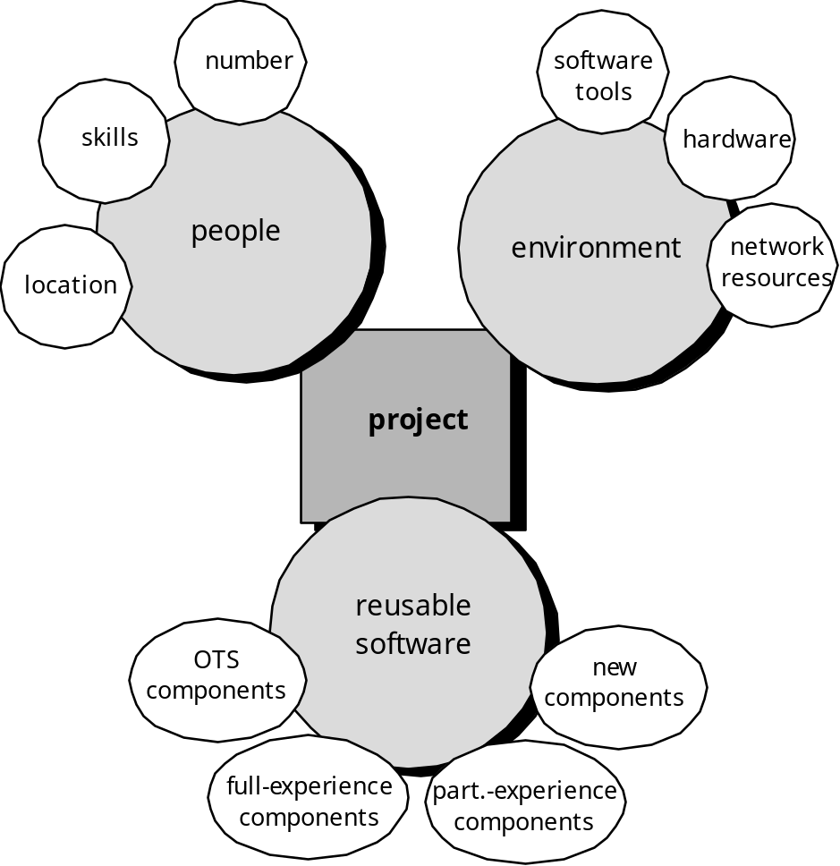
These courseware materials are to be used in conjunction with Software Engineering: A Practitioner’s Approach, 6/e and are provided with permission by R.S. Pressman & Associates, Inc., copyright © 1996, 2001, 2005

Slide 18
Human Resources –
  Project Planner begins by evaluating software scope and selecting the skills required to complete development
  Organizational Position (i.e. Manager, Sr. Manager etc.) and Specialty (Telecommunication, Database etc.) need to specify
  The number of people required for a software project can be determined only after an estimate of development effort
  For small projects – single individual perform all software engineering task
  For large projects – software team may be geographically dispersed across number of different location
These courseware materials are to be used in conjunction with Software Engineering: A Practitioner’s Approach, 6/e and are provided with permission by R.S. Pressman & Associates, Inc., copyright © 1996, 2001, 2005

Slide 19
Reusable Software Resources –
  Reusability = Creation and reuse of software building blocks
  Component-based Software Engineering emphasizes reusability
  Off-the-Shelf Components =
    COTS (Commercial Off-the-Shelf) software purchased from third party, ready for use on the current project and have been fully validated
  Full-Experience Components =
    Existing specifications, design, code or test data developed for past projects are similar to current project
    Modifications required for full-experience components will be relatively low risk
These courseware materials are to be used in conjunction with Software Engineering: A Practitioner’s Approach, 6/e and are provided with permission by R.S. Pressman & Associates, Inc., copyright © 1996, 2001, 2005

Slide 20
  Partial-Experience Components =
    Existing specifications, design, code or test data developed for past projects are similar to current project
    Modifications required for partial-experience components have fair degree of risk
  New Components =
    Software component must be built by the software team specifically for the needs of the current project
These courseware materials are to be used in conjunction with Software Engineering: A Practitioner’s Approach, 6/e and are provided with permission by R.S. Pressman & Associates, Inc., copyright © 1996, 2001, 2005

Slide 21
Environmental Resources –
  Software Engineering Environment incorporates hardware and software.
  Hardware provides a platform that supports the tools required to produce the work products
  When a computer-based-system system is to be developed, the software team may require access to hardware elements being developed by other engineering teams
These courseware materials are to be used in conjunction with Software Engineering: A Practitioner’s Approach, 6/e and are provided with permission by R.S. Pressman & Associates, Inc., copyright © 1996, 2001, 2005

Slide 22
Estimation
Estimation of resources, cost, and schedule for a software engineering effort requires
  Past Experience
  Access to good historical information
  Assumptions
  Identified Risk
Estimation carries inherent risk and this risk leads to uncertainty
These courseware materials are to be used in conjunction with Software Engineering: A Practitioner’s Approach, 6/e and are provided with permission by R.S. Pressman & Associates, Inc., copyright © 1996, 2001, 2005

Slide 23
The four basic steps in Software Project Estimation are −
  Estimate the size of the development product.
  Estimate the effort in person-months or person-hours.
  Estimate the schedule in calendar months.
  Estimate the project cost in agreed currency.
These courseware materials are to be used in conjunction with Software Engineering: A Practitioner’s Approach, 6/e and are provided with permission by R.S. Pressman & Associates, Inc., copyright © 1996, 2001, 2005

Slide 24
Observations on Estimation =
  Estimation need not be a one-time task in a project. It can take place during −
    Acquiring a Project.
    Planning the Project.
    Execution of the Project as the need arises.
  Project scope must be understood before the estimation process begins
  Planning requires technical managers and the software team to make an initial commitment as it leads to responsibility and accountability.
  Past experience can aid greatly.
These courseware materials are to be used in conjunction with Software Engineering: A Practitioner’s Approach, 6/e and are provided with permission by R.S. Pressman & Associates, Inc., copyright © 1996, 2001, 2005

Slide 25
General Project Estimation Approach =
  Step 1 − Understand the scope of the software to be built
  Step 2 − Generate an estimate of the software size
    Start with the statement of scope.
    Decompose the software into functions
    Calculate the size of each function.
    Combine function estimates to produce an overall estimate for the entire project.
These courseware materials are to be used in conjunction with Software Engineering: A Practitioner’s Approach, 6/e and are provided with permission by R.S. Pressman & Associates, Inc., copyright © 1996, 2001, 2005

Slide 26
  Step 3 − Generate an estimate of the effort and cost
    Identify the sequence of activities that need to be performed for the project to be completed.
    Divide activities into tasks that can be measured.
    Estimate the effort (in person hours/days) required to complete each task.
    Combine effort estimates of tasks of activity to produce an estimate for the activity.
  Step 4 − Reconcile estimates
    Compare the resulting values from Step 3 to those obtained from Step 2. If both sets of estimates agree, then your numbers are highly reliable. Otherwise, if widely divergent estimates occur conduct further investigation concerning whether
  Step 5 − Determine the cause of divergence and then reconcile the estimates
These courseware materials are to be used in conjunction with Software Engineering: A Practitioner’s Approach, 6/e and are provided with permission by R.S. Pressman & Associates, Inc., copyright © 1996, 2001, 2005

Slide 27
  Estimation Accuracy =
  Important factors that affect the accuracy of estimates are −
  The accuracy of all the estimate’s input data
  The accuracy of any estimate calculation
  The predictability of your organization’s software development process
  The stability of both the product requirements and the environment that supports the software engineering effort
  Whether or not the actual project was carefully planned, monitored and controlled, and no major surprises occurred that caused unexpected delays
These courseware materials are to be used in conjunction with Software Engineering: A Practitioner’s Approach, 6/e and are provided with permission by R.S. Pressman & Associates, Inc., copyright © 1996, 2001, 2005

Slide 28
Estimation Techniques =
Estimation Technique uses
  Decomposition of Problem
  Decomposition Process
Before to start estimation need to understand the scope of the project and generate an estimate of its size
These courseware materials are to be used in conjunction with Software Engineering: A Practitioner’s Approach, 6/e and are provided with permission by R.S. Pressman & Associates, Inc., copyright © 1996, 2001, 2005

Slide 29
Software Sizing =
In terms of Project Planning, sizing is quantifiable outcome of the software project
Problem-Based Estimation –
  Direct Approach – size represented as Line of Code (LOC)
  Indirect Approach – size is represented as Function Points (FP)
These courseware materials are to be used in conjunction with Software Engineering: A Practitioner’s Approach, 6/e and are provided with permission by R.S. Pressman & Associates, Inc., copyright © 1996, 2001, 2005

Slide 30
4 different approaches to the sizing problem –
  Fuzzy Logic Sizing
  Function Point Sizing
  Standard Component Sizing
  Change Sizing
Results of each of these approaches combined statically to create 3-point or expected-value estimate
These courseware materials are to be used in conjunction with Software Engineering: A Practitioner’s Approach, 6/e and are provided with permission by R.S. Pressman & Associates, Inc., copyright © 1996, 2001, 2005

Slide 31
Expected Value Estimation Variable is –
EV = (S_{opt} + 4S_{m} + S_{pess}) / 6
S_{opt} = Optimistic (low)
S_{m} = Most Likely
S_{pess} = Pessimistic (high)
Once Expected Value Estimation Variable has determined, LOC or FP productivity data are applied
These courseware materials are to be used in conjunction with Software Engineering: A Practitioner’s Approach, 6/e and are provided with permission by R.S. Pressman & Associates, Inc., copyright © 1996, 2001, 2005

Slide 32
There are many techniques that can be used to rigorously estimate or measure effort and cost for a software project, such as: -
  Function Point (FP)
  Source Lines of Code (SLOC)
  COnstructive COst MOdel (COCOMO)
  Delphi
These courseware materials are to be used in conjunction with Software Engineering: A Practitioner’s Approach, 6/e and are provided with permission by R.S. Pressman & Associates, Inc., copyright © 1996, 2001, 2005

Slide 33
Functional Point Method
FPA used to make estimate of software project including testing in terms of functionality or function size
Functional size of the product is measured in terms of the function point
These courseware materials are to be used in conjunction with Software Engineering: A Practitioner’s Approach, 6/e and are provided with permission by R.S. Pressman & Associates, Inc., copyright © 1996, 2001, 2005

Slide 34
Objectives of FPA =
  To measure and provide the software application functional size to the client, customer and the stakeholder
  Used to measure software project development along with its maintenance independently of the technology
  Should minimize overhead of the measurement process
These courseware materials are to be used in conjunction with Software Engineering: A Practitioner’s Approach, 6/e and are provided with permission by R.S. Pressman & Associates, Inc., copyright © 1996, 2001, 2005

Slide 35
Types of FPA =
Transactional Function Type =
  External Input (EI) = Elementary Process where Data or Control Information that comes from outside the application’s boundary
  External Output (EO) = Elementary Process that generates data or control information sent outside the application’s boundary
  External Inquiries (EQ) = Elementary Process made up of an input-output combination that results in data retrieval.
These courseware materials are to be used in conjunction with Software Engineering: A Practitioner’s Approach, 6/e and are provided with permission by R.S. Pressman & Associates, Inc., copyright © 1996, 2001, 2005

Slide 36
Data Functional Type =
  Internal Logical File = A user identifiable group of logically related data or control information maintained within the boundary of the application
  External Interface File = A group of users recognizable logically related data allusion to the software but maintained within the boundary of another software
These courseware materials are to be used in conjunction with Software Engineering: A Practitioner’s Approach, 6/e and are provided with permission by R.S. Pressman & Associates, Inc., copyright © 1996, 2001, 2005

Slide 37
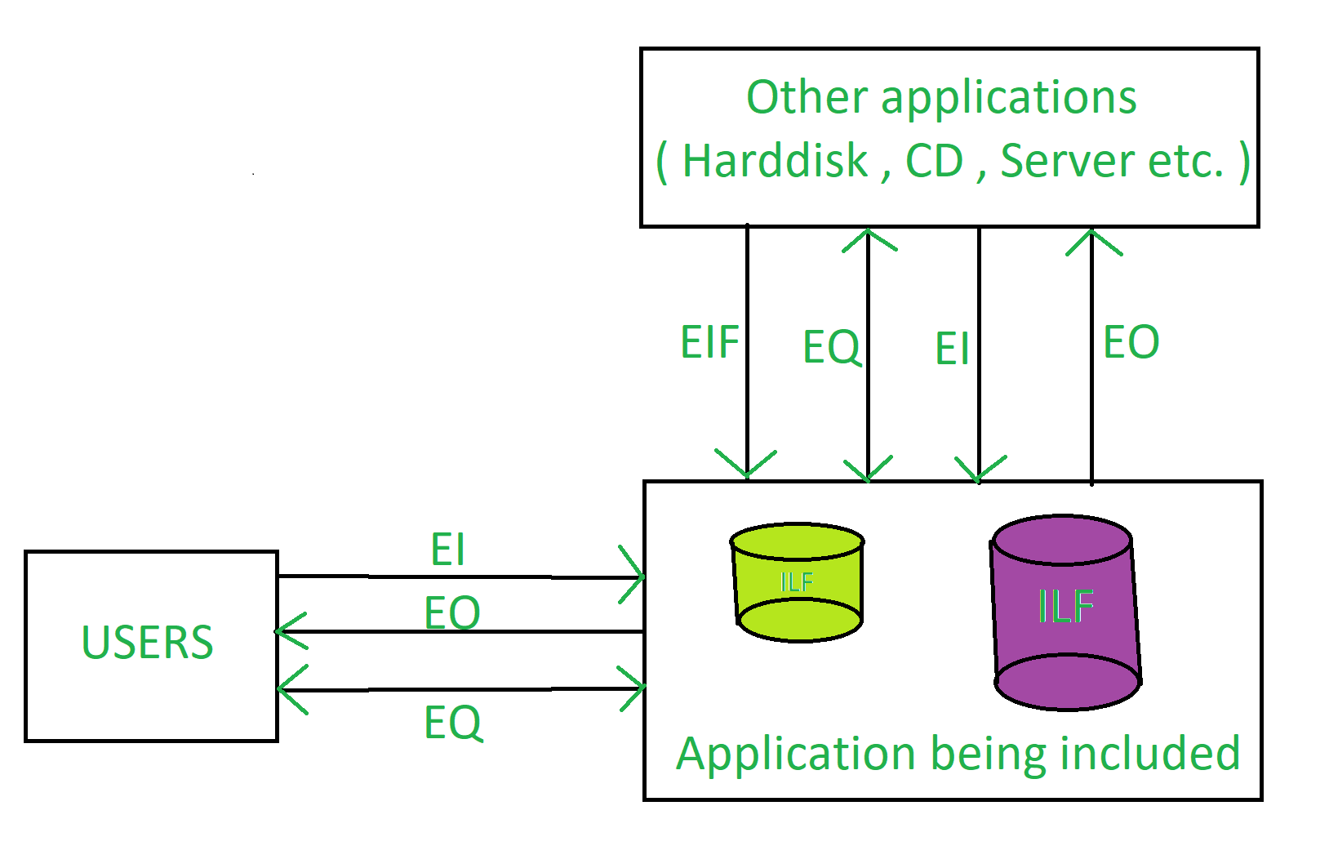
These courseware materials are to be used in conjunction with Software Engineering: A Practitioner’s Approach, 6/e and are provided with permission by R.S. Pressman & Associates, Inc., copyright © 1996, 2001, 2005

Slide 38
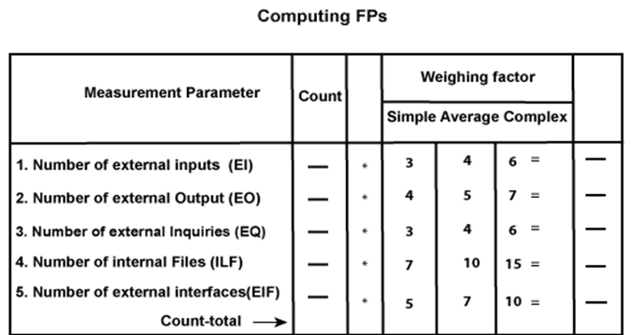
Function Point Analysis and Weight Factor Table –
FP = Count-total * [0.65 + 0.01 * ∑(fi)]
= Count-total * Complexity Adjustment Factor
( 0 <= ∑(f_{i}) <=70)
These courseware materials are to be used in conjunction with Software Engineering: A Practitioner’s Approach, 6/e and are provided with permission by R.S. Pressman & Associates, Inc., copyright © 1996, 2001, 2005

Slide 39
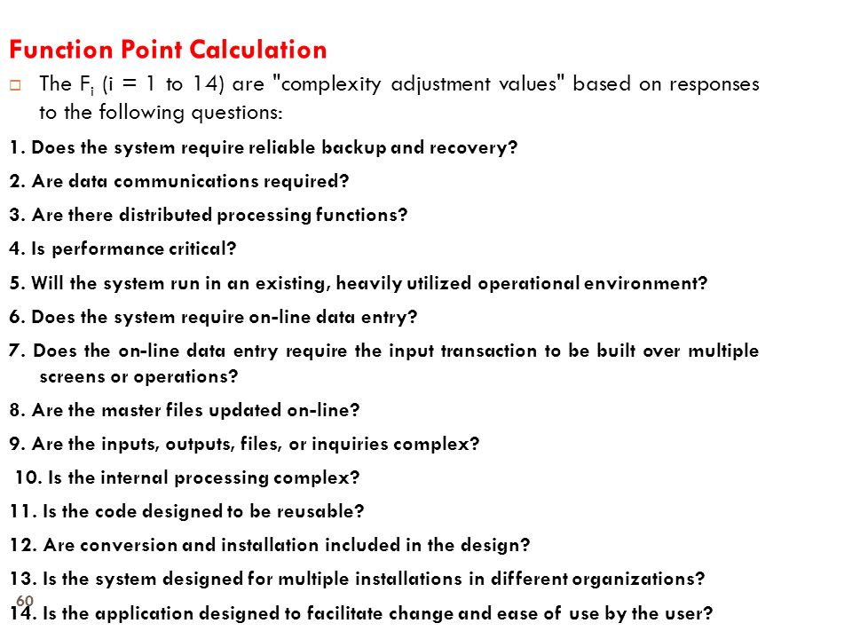
These courseware materials are to be used in conjunction with Software Engineering: A Practitioner’s Approach, 6/e and are provided with permission by R.S. Pressman & Associates, Inc., copyright © 1996, 2001, 2005

Slide 40
Ex.-1: Compute the function point, productivity, documentation, cost per function for the following data:
  Number of user inputs = 24
  Number of user outputs = 46
  Number of inquiries = 8
  Number of files = 4
  Number of external interfaces = 2
  Effort = 36.9 p-m
  Technical documents = 265 pages
  User documents = 122 pages
  Cost = $7744/ month
  Various processing complexity factors are: 4, 1, 0, 3, 3, 5, 4, 4, 3, 3, 2, 2, 4, 5.
These courseware materials are to be used in conjunction with Software Engineering: A Practitioner’s Approach, 6/e and are provided with permission by R.S. Pressman & Associates, Inc., copyright © 1996, 2001, 2005

Slide 41
Solution:
Assume, weighing factor is average –
  Count-total = (24*4) + (46*5) + (8*4) + (4*10) + (2*7)
= 96 + 230 + 32 + 40 + 14
= 412
  ∑(fi)] = 4 + 1 + 0 + 3 + 3 + 5 + 4 + 4 + 3 + 3 + 2 + 2 + 4 + 5
= 43
  FP = Count-total * [0.65 + 0.01 * ∑(fi)]
= 412 * [0.65 + 0.01 * 43]
= 412 * 1.08
= 444.96
These courseware materials are to be used in conjunction with Software Engineering: A Practitioner’s Approach, 6/e and are provided with permission by R.S. Pressman & Associates, Inc., copyright © 1996, 2001, 2005

Slide 42
  Productivity = FP / Efforts
= 444.96 / 36.9
= 12.0585
  Total Pages of Documentation = Technical Docs + User Docs
  = 265 + 122
  = 387 pages
  Documentation = Pages of Documentation / FP
  = 387 / 444.96
  0.869
  Cost per function = Cost / Productivity
  = 7744 / 12.085
  = $642.2026
These courseware materials are to be used in conjunction with Software Engineering: A Practitioner’s Approach, 6/e and are provided with permission by R.S. Pressman & Associates, Inc., copyright © 1996, 2001, 2005

Slide 43
Ex.-2: Calculate the function point, productivity, documentation, and cost per function for software application with multiple Processing Factors 5, 1, 0, 4, 3, 5, 4, 3, 4, 5, 2, 3, 4, 2 by using following given Data:
  The number of EI(Avg): 22
  The number of EO(Avg): 45
  The number of EQ(High): 06
  The number of ILF(Avg): 05
  The number of ELF(Low): 02
  Effort:37 PM
  Software technical documents: 250 pages
  User related documents: 120 pages
  Budgeting/Cost: $7520 per month
These courseware materials are to be used in conjunction with Software Engineering: A Practitioner’s Approach, 6/e and are provided with permission by R.S. Pressman & Associates, Inc., copyright © 1996, 2001, 2005

Slide 44
Solution:
  Count-total = (22*4) + (45*5) + (6*6) + (5*10) + (2*5)
= 88 + 225 + 36 + 50 + 10
= 409
  ∑(fi)] = 5 + 1 + 0 + 4 + 3 + 5 + 4 + 3 + 4 + 5 + 2 + 3 + 4 + 2
= 45
  FP = Count-total * [0.65 + 0.01 * ∑(fi)]
= 409 * [0.65 + 0.01 * 45]
= 409 * 1.10
= 450
These courseware materials are to be used in conjunction with Software Engineering: A Practitioner’s Approach, 6/e and are provided with permission by R.S. Pressman & Associates, Inc., copyright © 1996, 2001, 2005

Slide 45
  Productivity = FP / Efforts
= 450 / 37
= 12.16
  Total Pages of Documentation = Technical Docs + User Docs
  = 250 + 120
  = 370 pages
  Documentation = Pages of Documentation / FP
  = 370 / 450
  = 0.82
  Cost per function = Cost / Productivity
  = 7520 / 12.16
  = $618.5
These courseware materials are to be used in conjunction with Software Engineering: A Practitioner’s Approach, 6/e and are provided with permission by R.S. Pressman & Associates, Inc., copyright © 1996, 2001, 2005

Slide 46
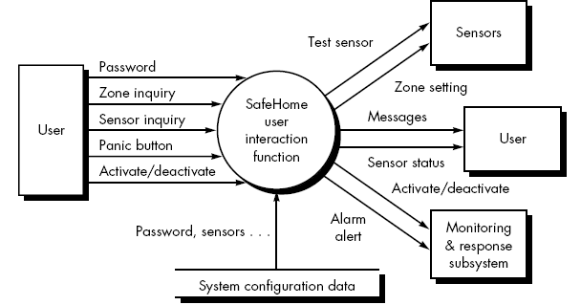
Ex-3:
These courseware materials are to be used in conjunction with Software Engineering: A Practitioner’s Approach, 6/e and are provided with permission by R.S. Pressman & Associates, Inc., copyright © 1996, 2001, 2005

Slide 47
  Number of user inputs = 3 (password, panic button, and activate/deactivate)
  Number of user outputs = 2 (massages and sensor status)
  Number of user inquiries = 2 (zone inquiry and sensor inquiry)
  Number of file = 1 (system configuration file)
  Number of external interfaces = 4 (test sensor, zone setting, activate/deactivate, and alarm alert)
  Solution:
  FP = 56
These courseware materials are to be used in conjunction with Software Engineering: A Practitioner’s Approach, 6/e and are provided with permission by R.S. Pressman & Associates, Inc., copyright © 1996, 2001, 2005

Slide 48
Extended Functional Point Method
FP metric has been further extended to compute: Feature Points
  Feature point is the superset of function point measure that can be applied to systems and engineering software applications.
  The feature points are used in those applications in which the algorithmic complexity is high like real-time systems where time constraints are there, embedded systems, etc.
  Feature points are computed by counting the information domain values and are weighed by only single weight.
  Feature point includes another measurement parameter-Algorithm
These courseware materials are to be used in conjunction with Software Engineering: A Practitioner’s Approach, 6/e and are provided with permission by R.S. Pressman & Associates, Inc., copyright © 1996, 2001, 2005

Slide 49
Line of Code (LOC) Method
Direct approach and requires higher level of details
Size oriented measure derived by considering the size of software
A simple set of size of measure –
  Size = Kilo Lines of Code
  Effort = Person / Month
  Productivity = KLOC / person-month
  Quality = Number of faults / KLOC
  Cost = $ / KLOC
  Documentation = Pages of Documentation / KLOC
These courseware materials are to be used in conjunction with Software Engineering: A Practitioner’s Approach, 6/e and are provided with permission by R.S. Pressman & Associates, Inc., copyright © 1996, 2001, 2005

Slide 50
Estimating or calculating the size of the project
The project size helps determine the resources, effort, cost, and duration required to complete the project
It is also used to directly calculate the effort to be spent on a project
This technique includes the calculation of lines of codes (LOC), documentation of pages, inputs, outputs, and components of a software program
Generally, it can be used when you are using third- generation language, such as FORTRAN or COBOL
These courseware materials are to be used in conjunction with Software Engineering: A Practitioner’s Approach, 6/e and are provided with permission by R.S. Pressman & Associates, Inc., copyright © 1996, 2001, 2005

Slide 51
To count the LOC the following must be considered:
  The count includes: -
    The SLOC delivered to client
    The SLOC written only by the development team are counted
    The declaration statements are counted as source lines of code
  The count excludes:
    The code created by application generators.
    The comments inserted to improve the readability of program
These courseware materials are to be used in conjunction with Software Engineering: A Practitioner’s Approach, 6/e and are provided with permission by R.S. Pressman & Associates, Inc., copyright © 1996, 2001, 2005

Slide 52
Example: -
  Assume estimated lines of code of a system is: 33,200 LOC
  Average productivity for system of this type is: 620 LOC/person-month
  There are 6 developers
  Labor rate is: $ 800 per person-month
  Calculate the total effort and cost required to complete the above project
Solution: -
  Total Effort = Total LOC / Productivity
  = 33200 / 620 = 53.54 ≈ 54 person-months
  6 developers
    Effort = Total Effort / 6 = 54 / 6 = 9 months
  Total Cost = Total Effort * Labor Rate = 54 * 800 ≈ $43,200
These courseware materials are to be used in conjunction with Software Engineering: A Practitioner’s Approach, 6/e and are provided with permission by R.S. Pressman & Associates, Inc., copyright © 1996, 2001, 2005

Slide 53
Process-Based Estimation
Obtained from “process framework”
framework activities
application
functions
Effort required to accomplish
each framework activity for each application function
These courseware materials are to be used in conjunction with Software Engineering: A Practitioner’s Approach, 6/e and are provided with permission by R.S. Pressman & Associates, Inc., copyright © 1996, 2001, 2005

Slide 54
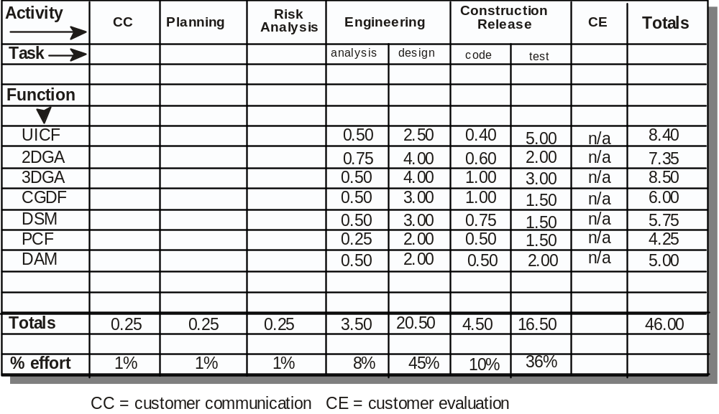
Process-Based Estimation Example
Based on an average burdened labor rate of $8,000 per month, the total estimated project cost is $368,000 and the estimated effort is 46 person-months.
These courseware materials are to be used in conjunction with Software Engineering: A Practitioner’s Approach, 6/e and are provided with permission by R.S. Pressman & Associates, Inc., copyright © 1996, 2001, 2005

Slide 55
Empirical Estimation Models
General form:
exponent
effort = tuning coefficient * size
usually derived
empirically
as person-months
derived
of effort required
usually LOC but
may also be
either a constant or
function point
a number derived based
on complexity of project
These courseware materials are to be used in conjunction with Software Engineering: A Practitioner’s Approach, 6/e and are provided with permission by R.S. Pressman & Associates, Inc., copyright © 1996, 2001, 2005

Slide 56
An estimation model for computer software uses empirically derived formulas to predict effort as a function of LOC or FP
Structure of Estimation Model =
  E = A + B * (e_{v})^{C}
    E is Effort in person-month
    A, B, C are empirically derived constants
    e_{v} is estimation variable (either LOC or FP)
These courseware materials are to be used in conjunction with Software Engineering: A Practitioner’s Approach, 6/e and are provided with permission by R.S. Pressman & Associates, Inc., copyright © 1996, 2001, 2005

Slide 57
COCOMO
COnstructive COst Estimation Model
COCOMO predicts the efforts and schedule of a software product based on the size of the software.
COCOMO II model requires sizing information
Three different sizing options are available as part of the model hierarchy: object points, function points, and lines of source code
These courseware materials are to be used in conjunction with Software Engineering: A Practitioner’s Approach, 6/e and are provided with permission by R.S. Pressman & Associates, Inc., copyright © 1996, 2001, 2005

Slide 58
COCOMO Estimation Models that address the following areas:
    Application composition model. Used during the early stages of software engineering, when prototyping of user interfaces, consideration of software and system interaction, assessment of performance, and evaluation of technology maturity are paramount.
    Early design stage model. Used once requirements have been stabilized and basic software architecture has been established.
    Post-architecture-stage model. Used during the construction of the software.
These courseware materials are to be used in conjunction with Software Engineering: A Practitioner’s Approach, 6/e and are provided with permission by R.S. Pressman & Associates, Inc., copyright © 1996, 2001, 2005

Slide 59
Three Development Modes –
  Organic Mode = Used for simple projects in which small teams work to a set of informal requirements
  Semi-detached Mode = Used for an intermediate project in which mixed teams must work to set of rigid and less than rigid requirements
  Embedded Mode = Used for a Project that must operate within a tight set of constaints
These courseware materials are to be used in conjunction with Software Engineering: A Practitioner’s Approach, 6/e and are provided with permission by R.S. Pressman & Associates, Inc., copyright © 1996, 2001, 2005

Slide 60
Basic Model =
  Estimate software development effort using only Lines of Code
    E = a * (KLOC) ^{b}
    D = C * (E)^{d}
    P = E / D
    Here, E = Effort D = Development Time
    P = total number of persons
    KLOC = Kilo Line Of Code for the project
  Coefficients a,b,c,d –
Software Projects | a | b | c | d
Organic | 2.4 | 1.05 | 2.5 | 0.38
Semi-detached | 3.0 | 1.12 | 2.5 | 0.35
Embedded | 3.6 | 1.20 | 2.5 | 0.32
These courseware materials are to be used in conjunction with Software Engineering: A Practitioner’s Approach, 6/e and are provided with permission by R.S. Pressman & Associates, Inc., copyright © 1996, 2001, 2005

Slide 61
  Example-1: Consider software project model using semi-detached mode with 30,000 lines of code.
  Solution:
  E = a * (KLOC)^{b}
  E = 3.0 * (30)^{1.12}
  E = 135 person-month
  D = c * (E)^{d}
  = 2.5 (135)^{0.35}
  = 14 months
  P = E / D
  = 135 / 14
  = 10 persons approx.
These courseware materials are to be used in conjunction with Software Engineering: A Practitioner’s Approach, 6/e and are provided with permission by R.S. Pressman & Associates, Inc., copyright © 1996, 2001, 2005

Slide 62
Intermediate Model =
  Makes use of set of cost driver attributes to compute the cost of software
  There is 6-point grade scale for 15 cost drive attributes
  E = a * (KLOC)^{b} * EAF (EAF = Effort Adjustment Factor)
  Coefficients – a, b, c, d –
Software Projects | a | b
Organic | 3.2 | 1.05
Semi-detached | 3.0 | 1.12
Embedded | 2.8 | 1.20
These courseware materials are to be used in conjunction with Software Engineering: A Practitioner’s Approach, 6/e and are provided with permission by R.S. Pressman & Associates, Inc., copyright © 1996, 2001, 2005

Slide 63
Detailed COCOMO Model =
  Four phases used in detailed COCOMO model are –
    Requirements Planning and Product Design (RPD)
    Detailed Design (DD)
    Code and Unit Test (CUT)
    Integrate and Test (IT)
Phases | Very Low | Low | Nominal | High | Very High
RPD | 1.80 | 0.85 | 1.00 | 0.75 | 0.55
DD | 1.35 | 0.85 | 1.00 | 0.90 | 0.75
CUT | 1.35 | 0.85 | 1.00 | 0.90 | 0.75
IT | 1.50 | 1.20 | 1.00 | 0.85 | 0.70
These courseware materials are to be used in conjunction with Software Engineering: A Practitioner’s Approach, 6/e and are provided with permission by R.S. Pressman & Associates, Inc., copyright © 1996, 2001, 2005

Slide 64
Ex.-1: Using COCOMO estimate time required for the following –
  Semi-detached model of software project of 2000 lines
  Embedded model of software project of 30,000 lines
Solution:
  LOC = 2KLOC
  E = a * (KLOC)^{b} = 3 * (2)^{1.12}
  = 6.520 pm
  D = c * (E)^{d} = 2.5 * (6.520)^{0.35}
  = 4.818 months
  P = E/D = 6.520 / 4.818
  = 1.35 =
These courseware materials are to be used in conjunction with Software Engineering: A Practitioner’s Approach, 6/e and are provided with permission by R.S. Pressman & Associates, Inc., copyright © 1996, 2001, 2005

Slide 65
Estimation for OO Projects-I
Develop estimates using effort decomposition, FP analysis, and any other method that is applicable for conventional applications.
Using object-oriented analysis modeling (Chapter 8), develop use-cases and determine a count.
From the analysis model, determine the number of key classes (called analysis classes in Chapter 8).
Categorize the type of interface for the application and develop a multiplier for support classes:
  Interface type Multiplier
  No GUI 2.0
  Text-based user interface 2.25
  GUI 2.5
  Complex GUI 3.0
These courseware materials are to be used in conjunction with Software Engineering: A Practitioner’s Approach, 6/e and are provided with permission by R.S. Pressman & Associates, Inc., copyright © 1996, 2001, 2005

Slide 66
Estimation for OO Projects-II
Multiply the number of key classes (step 3) by the multiplier to obtain an estimate for the number of support classes.
Multiply the total number of classes (key + support) by the average number of work-units per class. Lorenz and Kidd suggest 15 to 20 person-days per class.
Cross check the class-based estimate by multiplying the average number of work-units per use-case
These courseware materials are to be used in conjunction with Software Engineering: A Practitioner’s Approach, 6/e and are provided with permission by R.S. Pressman & Associates, Inc., copyright © 1996, 2001, 2005

Slide 67
Estimation for Agile Projects
Each user scenario (a mini-use-case) is considered separately for estimation purposes.
The scenario is decomposed into the set of software engineering tasks that will be required to develop it.
Each task is estimated separately. Note: estimation can be based on historical data, an empirical model, or “experience.”
  Alternatively, the ‘volume’ of the scenario can be estimated in LOC, FP or some other volume-oriented measure (e.g., use-case count).
Estimates for each task are summed to create an estimate for the scenario.
  Alternatively, the volume estimate for the scenario is translated into effort using historical data.
The effort estimates for all scenarios that are to be implemented for a given software increment are summed to develop the effort estimate for the increment.
These courseware materials are to be used in conjunction with Software Engineering: A Practitioner’s Approach, 6/e and are provided with permission by R.S. Pressman & Associates, Inc., copyright © 1996, 2001, 2005

Slide 68
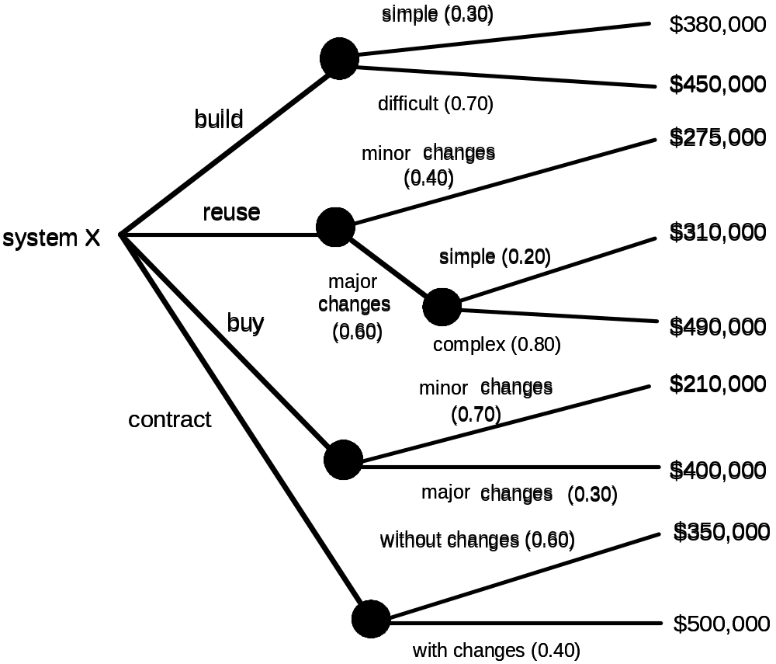
The Make-Buy Decision
These courseware materials are to be used in conjunction with Software Engineering: A Practitioner’s Approach, 6/e and are provided with permission by R.S. Pressman & Associates, Inc., copyright © 1996, 2001, 2005

Slide 69
Computing Expected Cost
expected cost =
(path probability) x (estimated path cost)
i
i
For example, the expected cost to build is:
expected cost = 0.30 ($380K) + 0.70 ($450K)
build
= $429 K
similarly,
expected cost = $382K
reuse
expected cost = $267K
buy
expected cost = $410K
contr
These courseware materials are to be used in conjunction with Software Engineering: A Practitioner’s Approach, 6/e and are provided with permission by R.S. Pressman & Associates, Inc., copyright © 1996, 2001, 2005

